Slide 1
Coders club
Department of Computer Science and Engineering
Dayananda Sagar University
NodeJS and Modules

Slide 2
Learning Objective
Understanding of the following
History of NodeJS.
What is NodeJS?
Why NodeJS?
Setting up of NodeJS
Problems
Modules
Problems on modules
Coders club

Slide 3
History of NodeJS
Developed in 2009
Published in 2011. (Linux Only)
Developed by Ryan Dahl
In June 2011 Joyent implemented a native windows version of NodeJS
Coders club

Slide 4
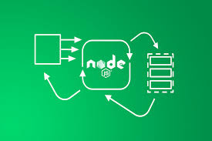
What is NodeJS?
Open source, Cross-Platform, JavaScript runtime environment.
NodeJS runs on Chrome’s V8 engine.
Executes JS outside the web browser.
Non blocking, single threaded, event driven servers.
Coders club

Slide 5
Why NodeJS?
Lot of tools and frameworks are available around NodeJS.
Ex:- React, Angular, Express
Node JS is fast compared to Ruby and Python.
It has become very popular among the developers.
It has huge community support.
Coders club

Slide 6
Advantages
Simple to learn
High Performance
Large community support
Coders club

Slide 7
When to use and when not to use Node JS?
It is ideal to use NodeJS when:
When you have lot of asynchronous requests.
Same language on server and client side.
Used to develop Single Page Applications (SPA)
It is recommended not to use NodeJS when:
When request is dependent on data intensive tasks.
Coders club

Slide 8
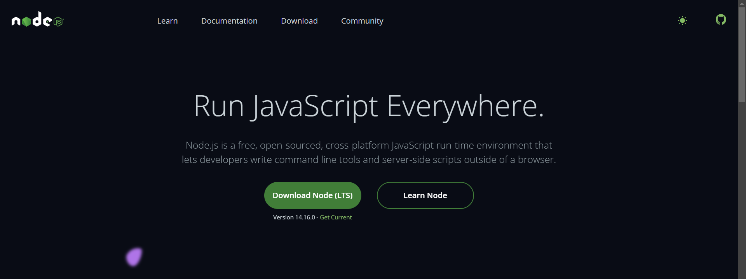
Getting Started
NodeJS can be obtained form https://nodejs.dev
Click on download Node(LTS) Button to start downloading the installer.
Double click on installer and follow on screen instructions to install NodeJS.
Coders club

Slide 9
Problems
Write a hello world program
Write a program to add, subtract, multiply, divide two numbers and print the result
Write a program to concatenate two strings
Write a program to verify age. Print Eligible to vote if above 18 print Not Eligible to vote if below 18
Write a program to find given character is vowel or consonant
Write a program to print all the numbers from 1 to 20
Write a program to print even numbers only till 20
Write a program to print odd numbers only till 20
Write a program to print all numbers from 1 to 20 using while loop
Coders club

Slide 10
Problems
Write a program to find sum of numbers in array
Write a program to print all the elements in array using foreach loop
Write a program to generate 20 random numbers between 1 to 100
Write a program to check if the given number is prime number
Write a program to check if the given string is palindrome
Coders club

Slide 11
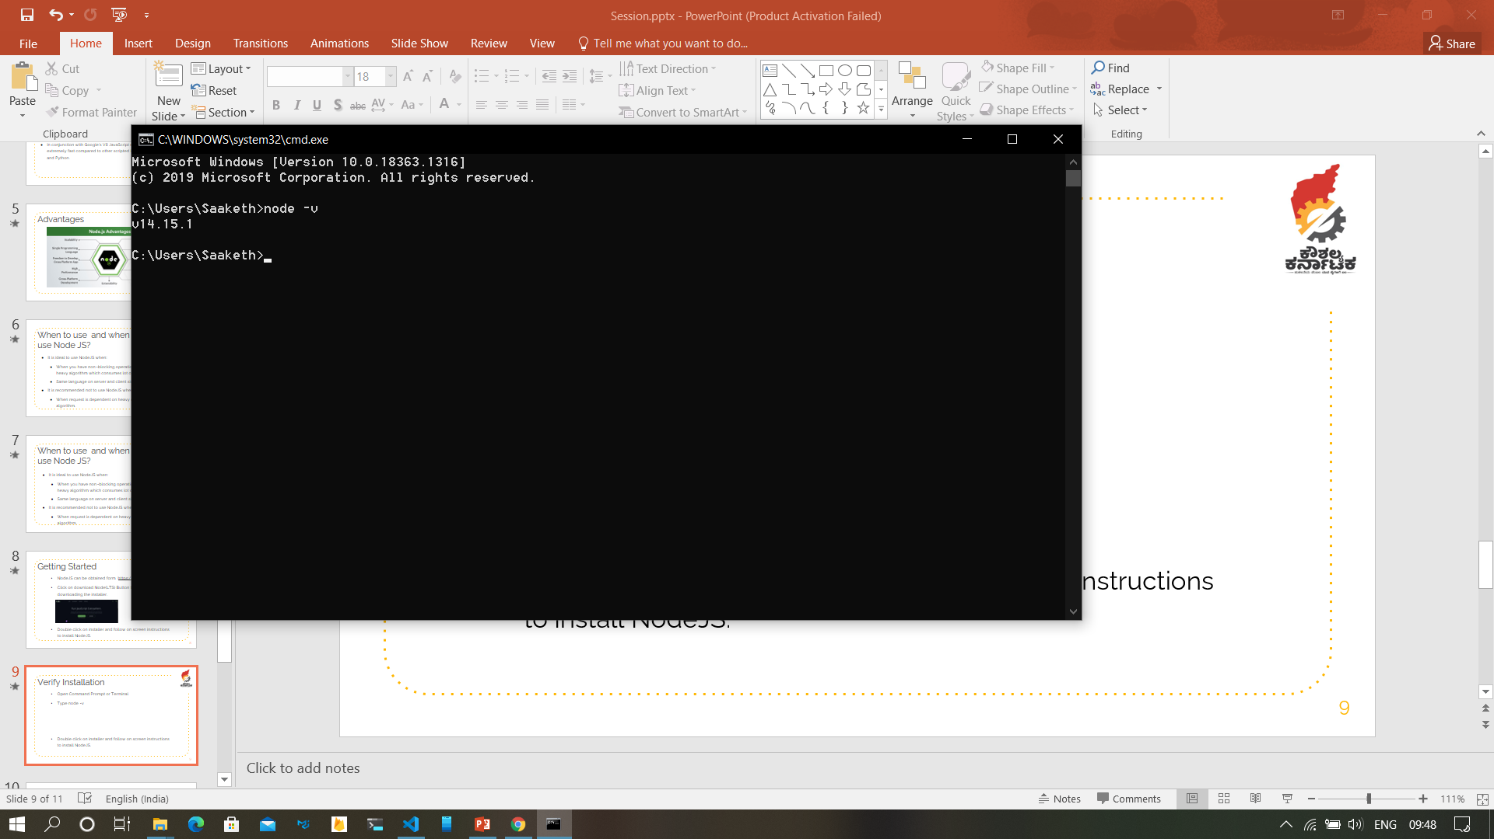
Verify Installation
Open Command Prompt or Terminal
Type node -v
The installed version of node is printed on Command prompt or terminal if node is installed.
Coders club

Slide 12
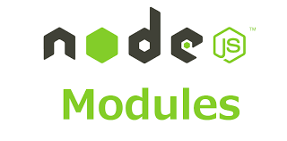
Modules
Modules are the set of JavaScript functions which can be reused in your application.
There are two types of Modules:
Built In Modules (Bundled with NodeJS).
User Defined Modules (Defined by Developers).
Coders club

Slide 13
Built in Modules
NodeJS is bundled with some of the Modules which can be used without any Installation.
Example: - http, fs, url …etc.
Modules can be included in the program using require function
http = require(‘http’)
The module that need to be included is to be passed as parameter

Slide 14
User Defined Modules
These are the module that are defined by developers.
These modules are to be developed or to be installed before using them.
These are included as same way as Built in modules are included.
http = require(‘./mymodule’)
Coders club

Slide 15
Problem
Create two modules one to find area and perimeter of square and other to find area and perimeter of circle. Include in program to find area and perimeter of Square and Circle.
Coders club

Slide 16
Summary
NodeJS is cross platform JavaScript runtime environment.
NodeJS can be used when response is not dependent on heavy computation.
NodeJS can be obtained from https://nodejs.dev
Basic Problems on Node JS.
Concept of modules and types of modules.
Coders club

